Slide 1
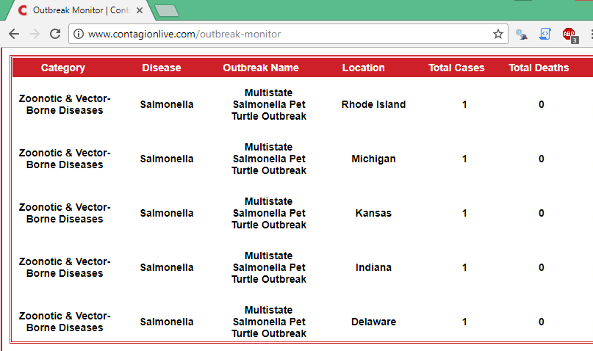


Extra (Web Scraping)
The rvest package is capable of extracting information from webpages (using CSS tags) and storing it directly into R
An example: http://www.contagionlive.com/outbreak-monitor

Slide 2
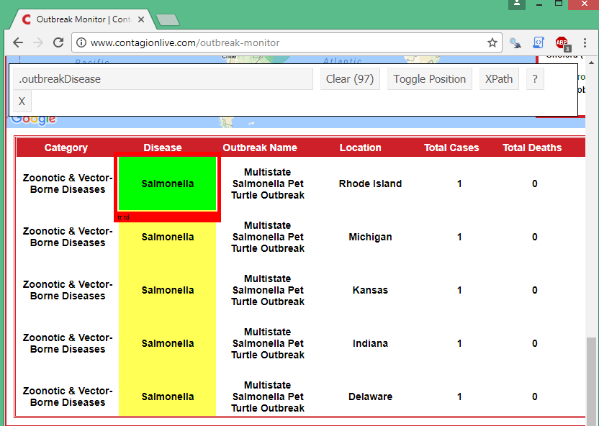
Extra (Web Scraping)
1st step is to identify the “tags” associated with each column of this data
Chrome has an extension to identify just this (Selector Gadget) – activate and hover
“tag”

Slide 3
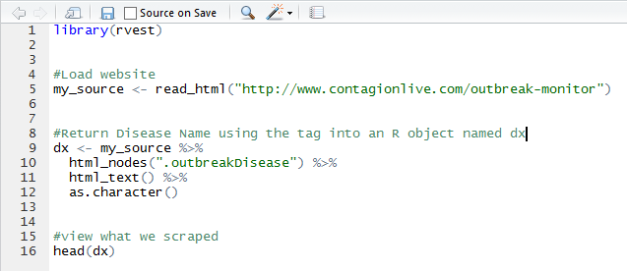
Extra (Web Scraping)
Let’s read this column into an R data frame

Slide 4
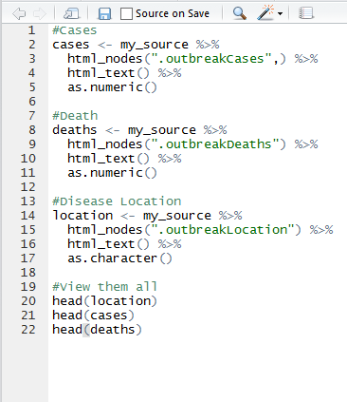
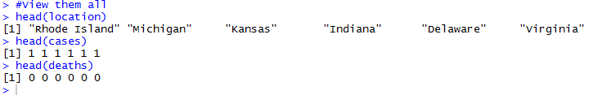
Extra (Web Scraping)
Repeat this process for all desired columns

Slide 5
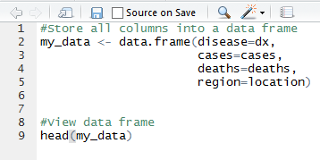
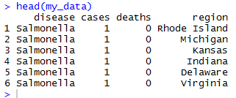
Extra (Web Scraping)
Put everything in one data frame, compare with website

Slide 6
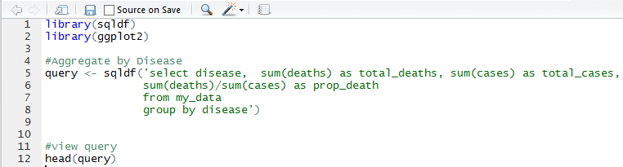
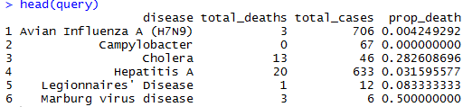
Extra (Web Scraping)
Now that results are in a data frame, you can do analysis with it.

Slide 7
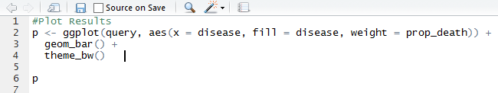
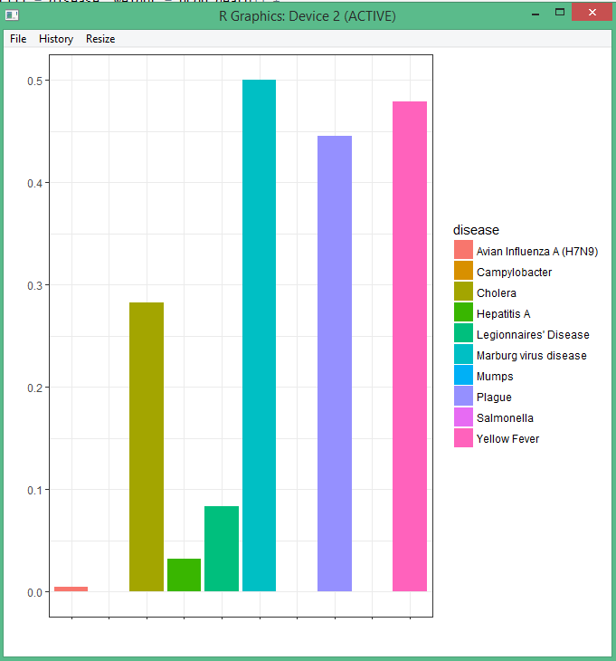
Extra (Web Scraping)
Now that results are in a data frame, you can do analysis with it.

Slide 8
Extra (Web Scraping)
Be mindful of the material you scrape (i.e. copyrights).
This demo was for educational purposes only.

